Slide 1
Alcohol Use Disorder Bench Card
Monitoring Best Practice
www.soberlink.com

Slide 2
Goals for a Parenting Plan with a parent who has AUD
Safety and Preserving the parent child relationship.
Empower the parent accused of obsessive drinking or who has AUD to prove sobriety. Give the parent tools that give visibility to sobriety and reinforces treatment.
Through the transparency of monitoring the co-parent can have peace of mind that the child is in a safe environment that ultimately strengthens the relationship.
The process is never weaponized – kids are never taken away permanently for non-compliance. There should always be a way to gain back parenting equity.
www.soberlink.com

Slide 3
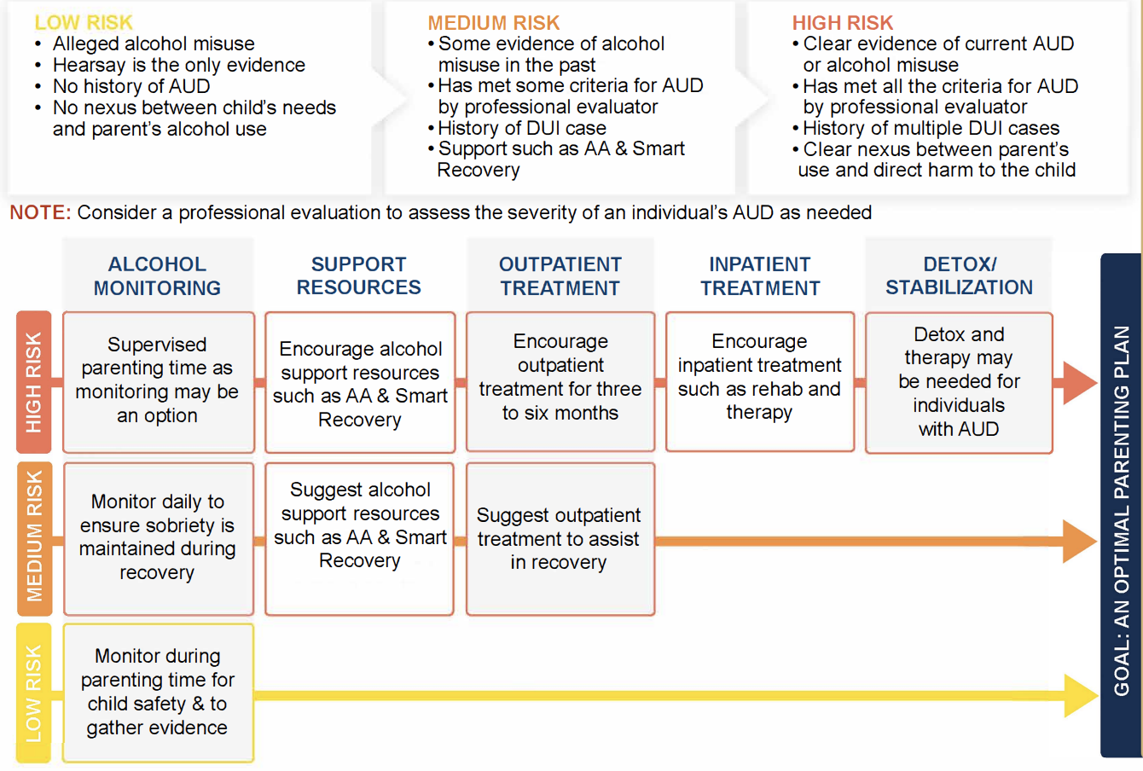
AUD Bench Card guides you through tool to consider where to start
Medical Detox
Inpatient Treatment
Outpatient Treatment
Support Groups
Supervised Visitations
Monitoring
Note: This is not an assessment tool
www.soberlink.com

Slide 4
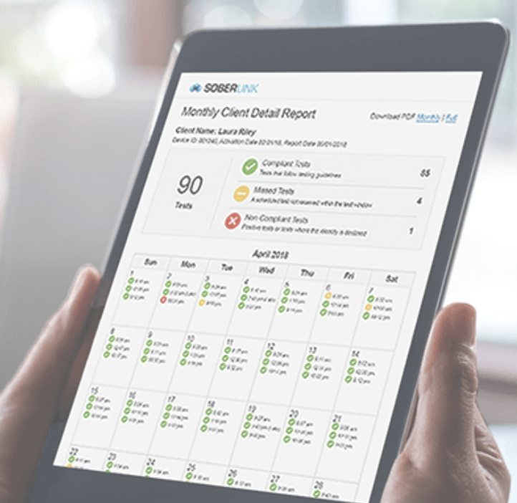
Monitoring used as an “anchor tool” for documenting sobriety
Real-time Results
Test from Anywhere at Anytime
Technology to confirm who is taking the test
Facial recognition to confirm identity
Tamper Detection
AUD is a mental illness
Reports to easily interpret results
Court Admissible
Allow for expert to testify
Features for successful monitoring.
www.soberlink.com

Slide 5
Family Assistance Program
Soberlink started a program in mid 2020
Free device and monitoring fees (over 70 programs have been awarded)
Parent qualifies as indigent
Attorney is representing parent Pro-Bono
Program has been suspended, but hope to reinstate in Feb of 2022
www.soberlink.com

